Slide 1


LIFE EXPECTANCY:
Data driven analysis into the factors affecting life expectancy

Slide 2
TABLE OF CONTENTS
Introduction
The Team
Understanding the Data
Clean the Data and exploration
Analysis
Insights

Slide 3
INTRODUCTION
This project was to provide analysis on Life Expectancy using detailed data analysis. The dataset used in this project was provided by World Health Organization. This project relies on the accuracy of data. Hence, a substantial amount of effort went into data cleaning which will be highlighted. The story of the data will be aided with visualizations throughout the presentation.

Slide 4
THE TEAM AT SANKOFA ANALYTICS
Efa Akoto
A Petroleum Geologist with a Master’s degree in Petroleum Geoscience from University of Ghana. She has been certified as a Data Scientist from Azubi Africa. She was a lead data scientist in ExxonMobil with an expertise in data analysis and modeling. She has led teams to execute projects effectively and efficiently. She is certified in Microsoft Azure Fundamentals.
Elvin Assiam
Elvin is a Senior Data Scientist, Scrum Master and Agile coach with years of experience. A data scientist with success stories with employers and clients. With his strong data analysis and data visualization , data is simplified in the best of ways possible for clients and good decision (effective and efficient Data Product) making for clients.
Ebo Ghartey-Koomson
Ebo is a Senior Data Analyst and a Cybersecurity expert, with years of experience working with Python and Excel. He has contributed to the success stories of many startups and has many awards under his belt.
Ebenezer Osei
Ebenezer is the Data Scientist for Sankofa Analytics. Eben also serves as a member of the Health, Law and Economic Workgroup of the Institute For New Economic Thinking. Prior to joining Sankofa Analytics in 2016, Eben was the Health Analyst for ArchiHealth Analytics. Eben brings more than 5 years of analytics experience and leadership to Sankofa Analytics

Slide 5

UNDERSTANDING THE DATA
The datasets obtained from The Global Health Observatory (GHO) data repository under World Health Organization (WHO) keeps track of the health status as well as many other related factors for all countries The datasets are made available to public for the purpose of health data analysis. The dataset related to life expectancy, health factors for 193 countries has been collected from the same WHO data repository website and its corresponding economic data was collected from United Nation website. Among all categories of health-related factors only those critical factors were chosen which are more representative. It has been observed that in the past 15 years , there has been a huge development in health sector resulting in improvement of human mortality rates especially in the developing nations in comparison to the past 30 years.

Slide 6
Therefore, in this project we have considered data from year 2000-2015 for 193 countries for further analysis. The individual data files have been merged into a single dataset. On initial visual inspection of the data showed some missing values. As the datasets were from WHO, we found no evident errors. Missing data was handled in R software by using Missmap command. The result indicated that most of the missing data was for population, Hepatitis B and GDP. The missing data were from less known countries like Vanuatu, Tonga, Togo, Cabo Verde etc. Finding all data for these countries was difficult and hence, it was decided that we exclude these countries from the final model dataset. The final merged file(final dataset) consists of 22 Columns and 2938 rows which meant 20 predicting variables. All predicting variables was then divided into several broad categories: Immunization related factors, Mortality factors, Economical factors and Social factors.

Slide 7
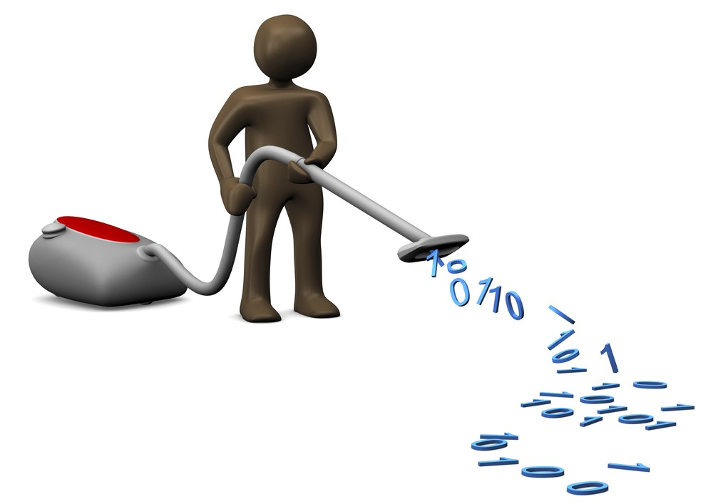
CLEANING THE DATA
Rename the columns to remove trailing spaces
Identify percentage of the null values in each column and remove the null values using interpolate
Detect outliers for each variable
Remove outliers using Winsorization technique (is the transformation of statistics by limiting extreme values in the statistical data to reduce the effect of possibly spurious outliers)
Drop columns which are largely affected by outliers (measles)
Confirm all outliers are removed

Slide 8
ANALYSIS: HYPOTHESIS 1
Developed countries have a higher life expectancy than developing countries.
QUESTIONS
What is the average life expectancy between developed and developing countries?
What is the average life expectancy between developed and developing countries over the years?
How is the percentage expenditure, total expenditure in countries with most and least life expectancy?
What is the adult mortality vs life expectancy between countries depending on development status?

Slide 9
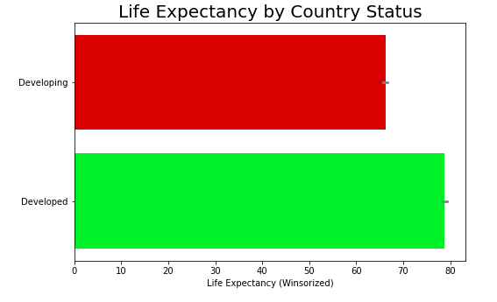
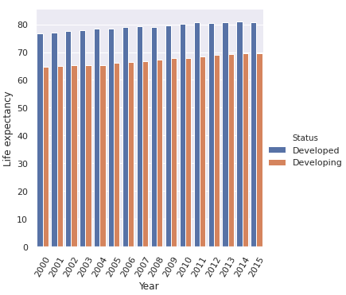
What is the average life expectancy between developed and developing countries?
What is the average life expectancy between developed and developing countries over the years?
From the above bar graph, we can see developed countries on average had a higher life expectancy, thus confirming our hypothesis
From the above bar graph, we can see developed countries have consistently on average had a higher life expectancy from year 2000-2015, thus confirming our hypothesis

Slide 10
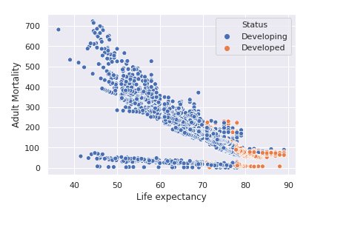
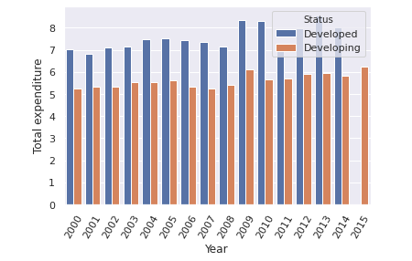
How is the percentage expenditure, total expenditure in countries with most and least life expectancy?
What is the adult mortality vs life expectancy between countries depending on development status?
From the above scatter graph, developed countries (orange dots) had a higher life expectancy than developing (blue dots). This confirms our hypothesis.

Slide 11
ANALYSIS: HYPOTHESIS TWO
Social factors of a country affect the life expectancy
QUESTIONS
Does Life Expectancy have a positive or negative relationship with drinking alcohol?
What is the impact of schooling on the lifespan of humans?

Slide 12
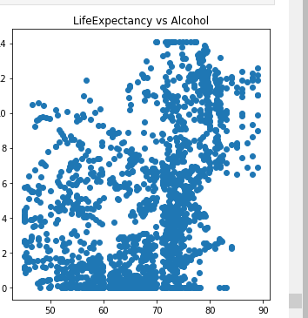
Does life expectancy have a positive or negative relationship with drinking alcohol?
The scatter plot diagram does not do enough to suggest any correlation, whether positive or negative, between life expectancy and alcohol.

Slide 13
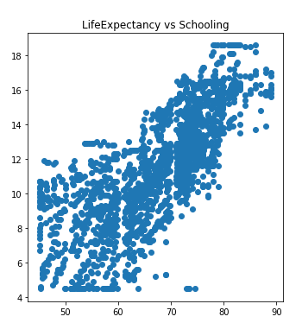
What is the impact of schooling on the lifespan of humans?
The diagram shows a positive relationship between Life expectancy and Schooling, as it shows a straight line to the right.

Slide 14
DATA EXPLORATION
Our approach to exploring the data was done to get a concise summary of the data.
The box plot of each variable helped to identify and determine outliers
Outliers for each variables was done so eliminate the irrelevant by using winsorizing
The number of Outliers after Winsorization for each variable was checked.
The calculation of the number of outliers and its percentage in each variable was accomplished by using Tukey's method.
Winsorized variables were then add to the data frame.

Slide 15
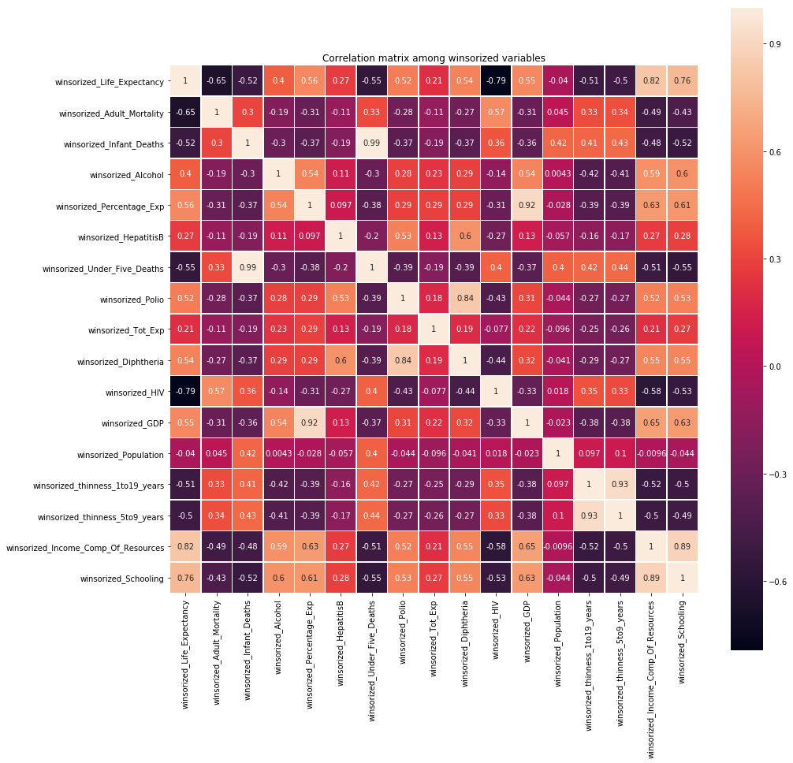
Visualization of winsorized variables affecting life expectancy

Slide 16
Insights from visualization
winsorized_Income_Comp_Of_Resources is correlated with winsorized_Schooling.
winsorized_thinness_1to19_years and winsorized_thinness_5to9_years are correlated.
winsorized_Polio and winsorized_Diphtheria are correlated.
winsorized_Percentage_Exp and winsorized_GDP are correlated.
winsorized_Income_Comp_Of_Resources and winsorized_Life_Expectancy are correlated.
winsorized_Life_Expectancy and winsorized_Schooling are correlated.
winsorized_Infant_Deaths and winsorized_Under_Five_Deaths are correlated.
winsorized_HIV has negative relation with winsorized_Life_Expectancy.
winsorized_Adult_Mortality has negative relation with winsorized_Life_Expectancy.

